Slide 1
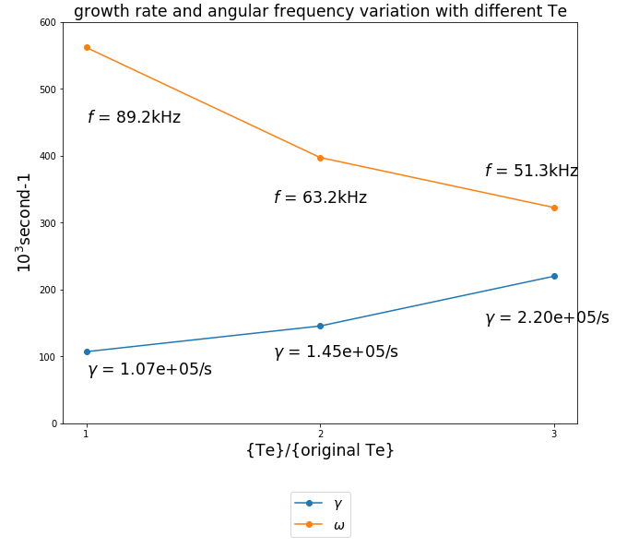
NO. 146094 DIII-D, GTC Linear Simulation Results while multiplying Te by 1, 2 and 3 times
n=4,m=6, q_min=1.44 nfilter =1, version 4.1.0
f* ≈ 40kHz

Slide 2
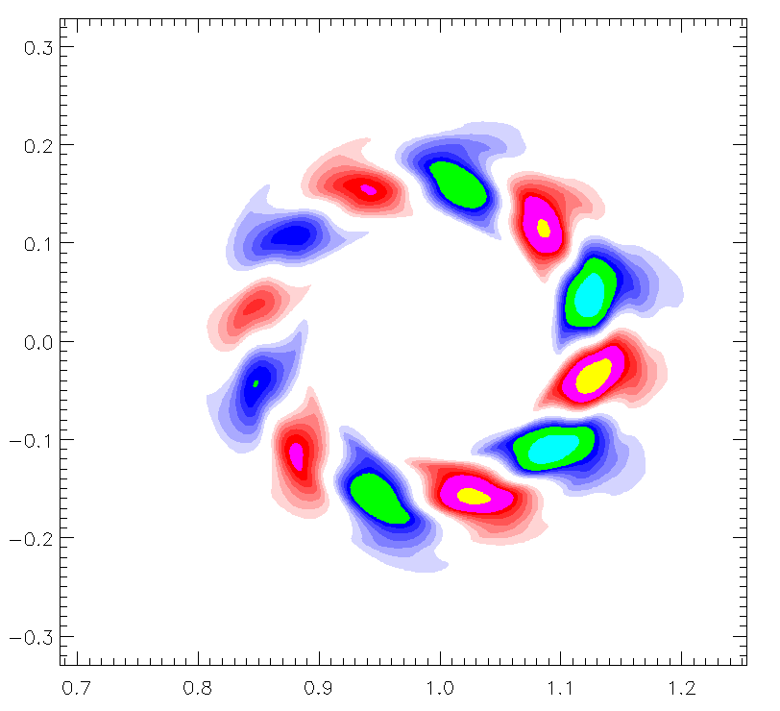
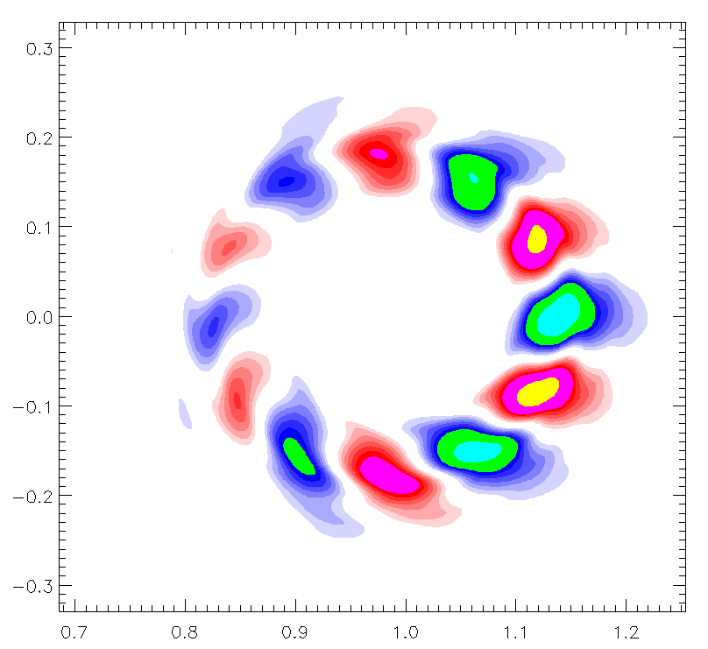
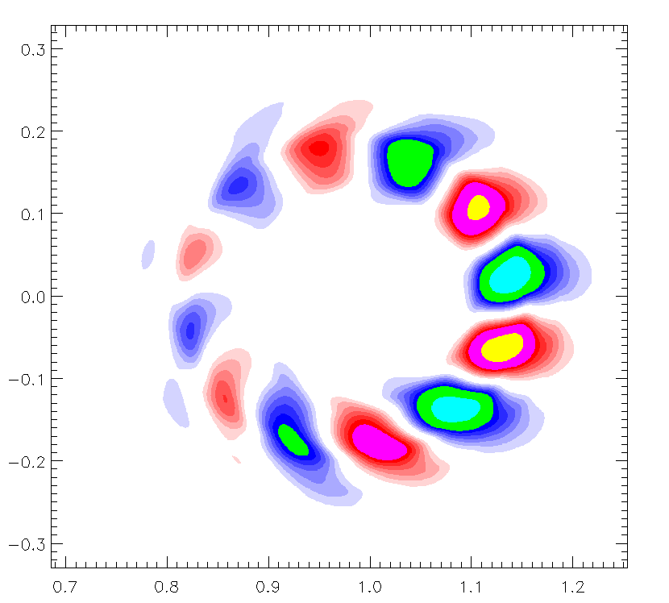
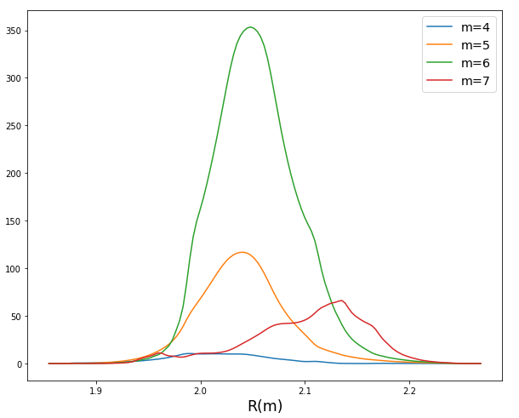
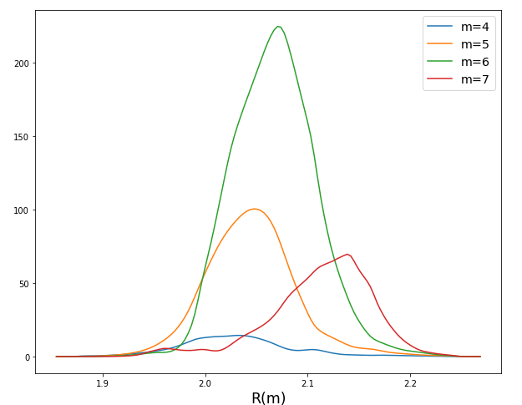
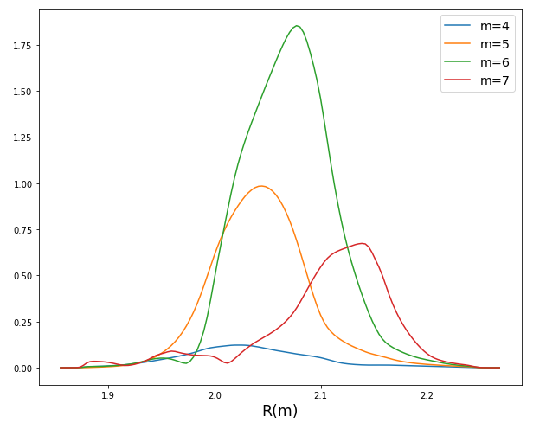
NO. 146094 DIII-D, electro-static potential mode structure while multiplying Te by 1, 2 and 3 times
n=4,m=6, q_min=1.44 nfilter =1, version 4.1.0
Poloidal
Radial
φ Snapshot
Te 2×Te 3×Te

Slide 3
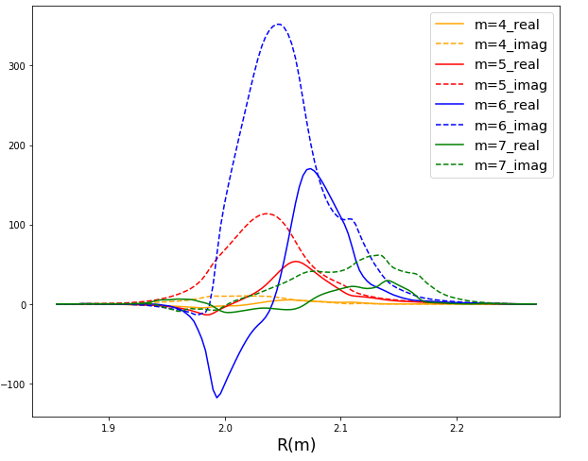
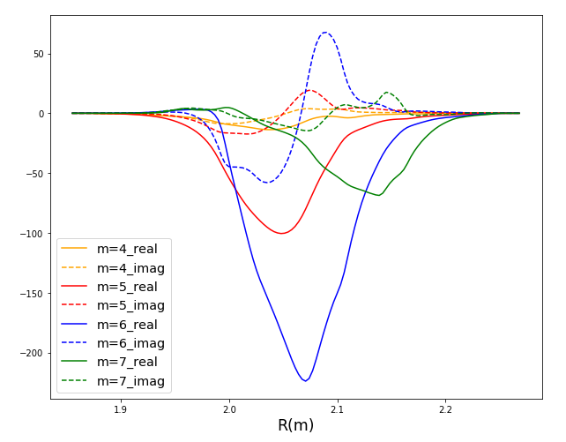
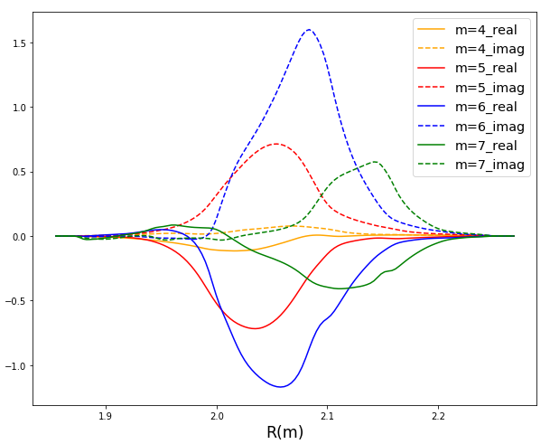
NO. 146094 DIII-D, electro-static potential radial structure while multiplying Te by 1, 2 and 3 times
n=4,m=6, q_min=1.44 nfilter =1, version 4.1.0
Te 2×Te 3×Te

Slide 4
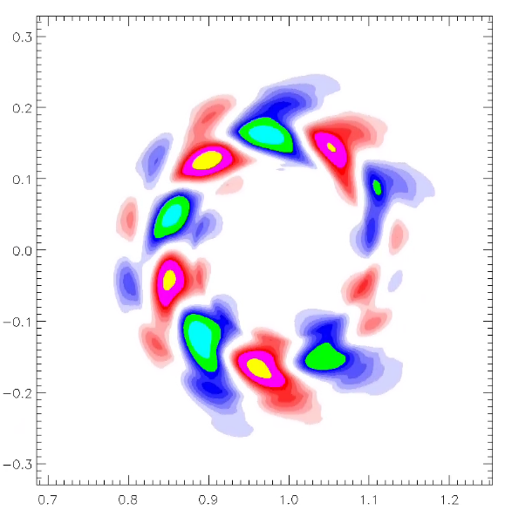
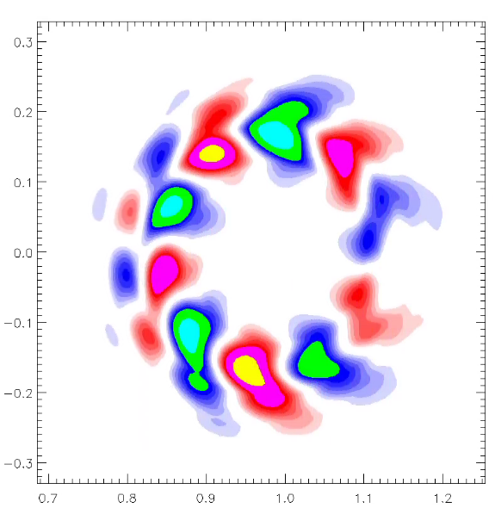
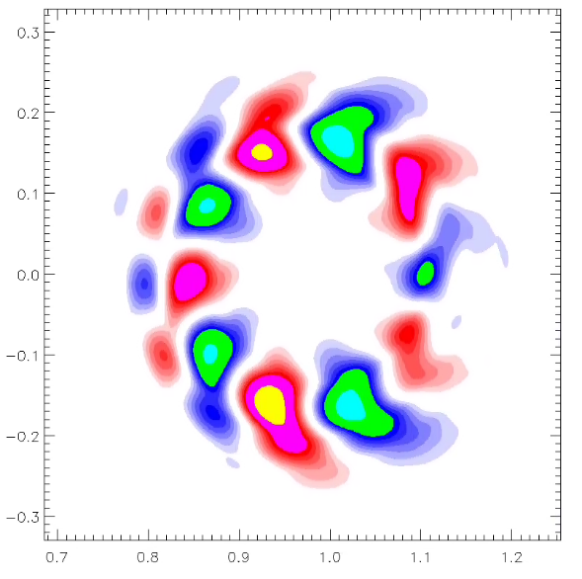
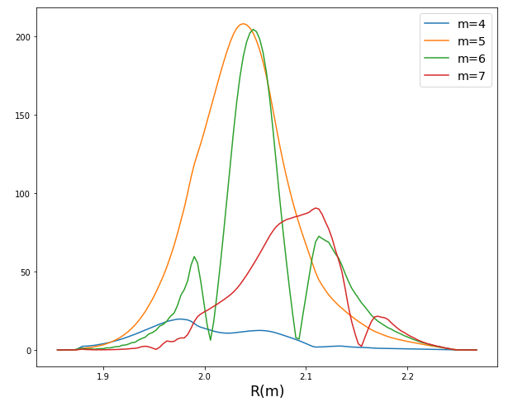
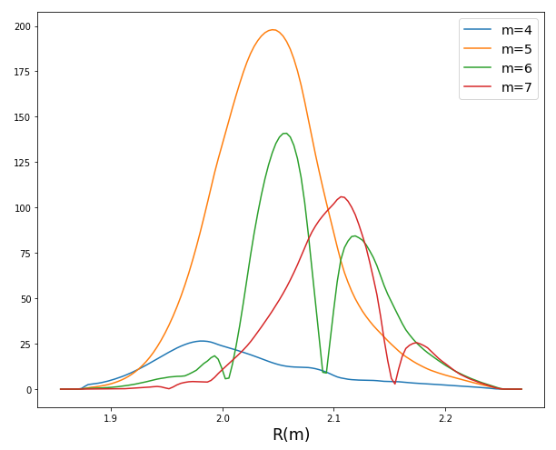
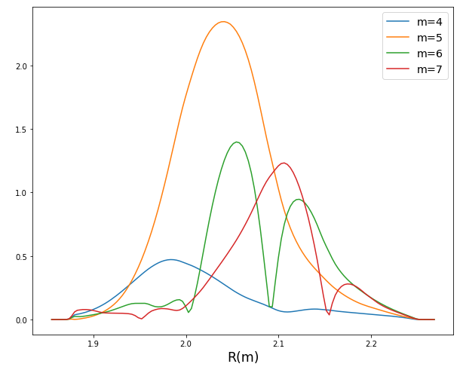

NO. 146094 DIII-D, parallel vector potential mode structure while multiplying Te by 1, 2 and 3 times
n=4,m=6, q_min=1.44 nfilter =1, version 4.1.0
Poloidal
Radial
$A_{\text{//}}$ Snapshot
Te 2×Te 3×Te

Slide 5
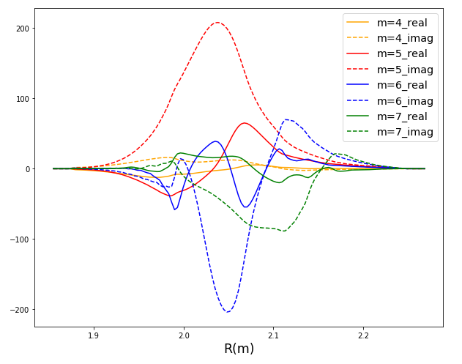
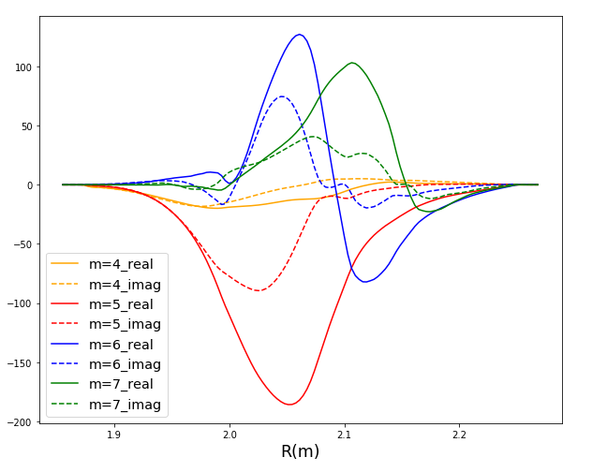
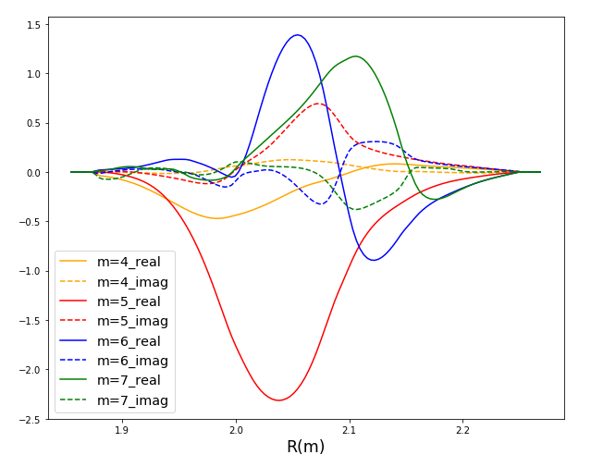
NO. 146094 DIII-D, parallel vector potential radial structure while multiplying Te by 1, 2 and 3 times
n=4,m=6, q_min=1.44 nfilter =1, version 4.1.0
Te 2×Te 3×Te

Slide 6
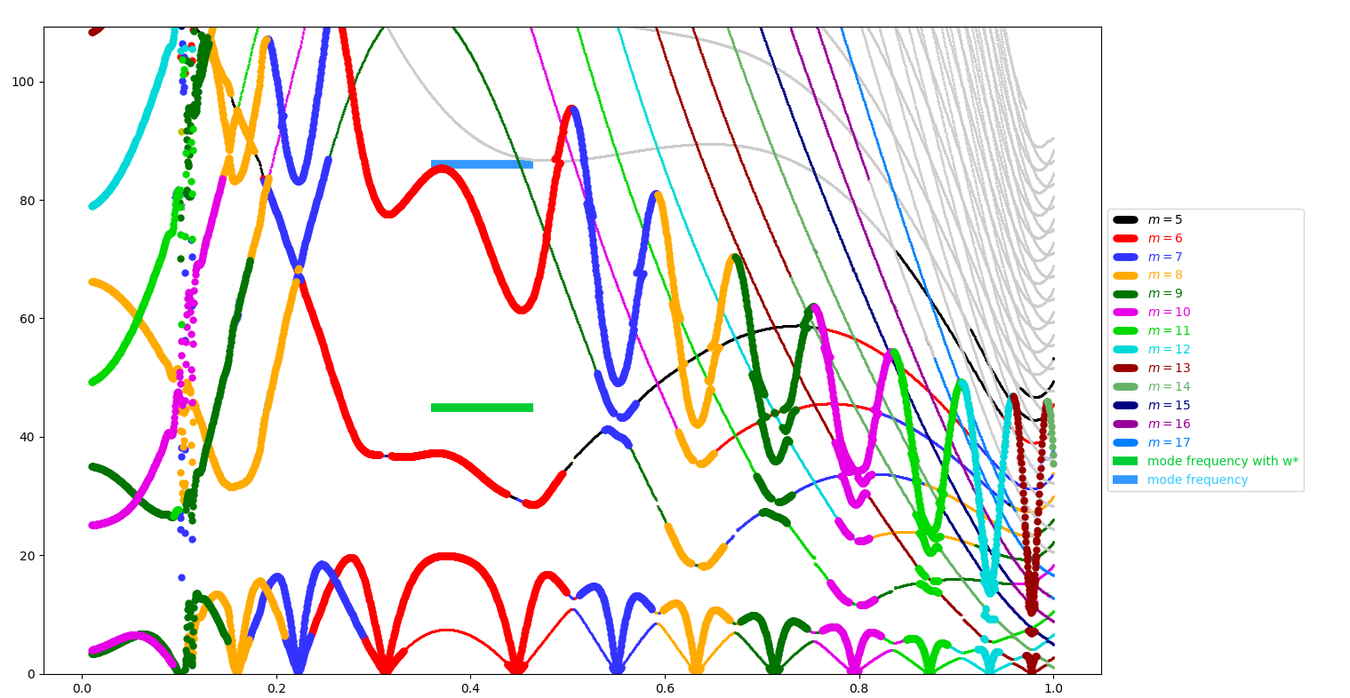
NO. 146094 DIII-D, n=4,m=6, q_min=1.44, Alcon Plot
kHz
Note:
The blue line is the frequency using the original profile. The green line is got by subtracting diamagnetic frequency f* from the blue line.
r/a

